Slide 1
PYTHON- PCEP
Dr Sivabalan,
Technical Training Advisor
Sivabalan.n@nttdata.com

Slide 2
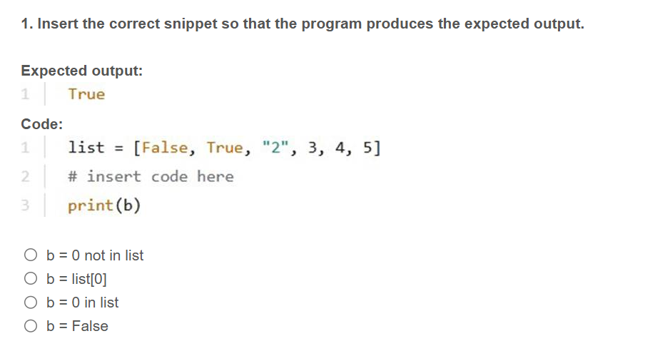


PCEP
.

Slide 3
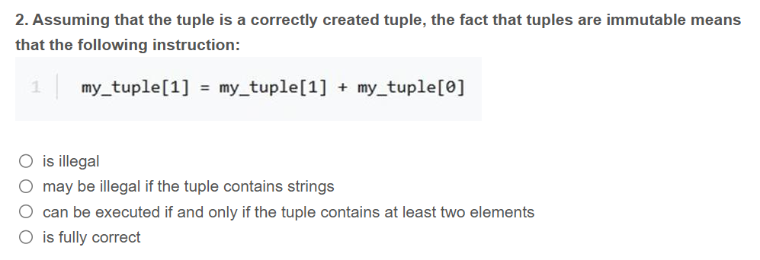
PCEP
.

Slide 4
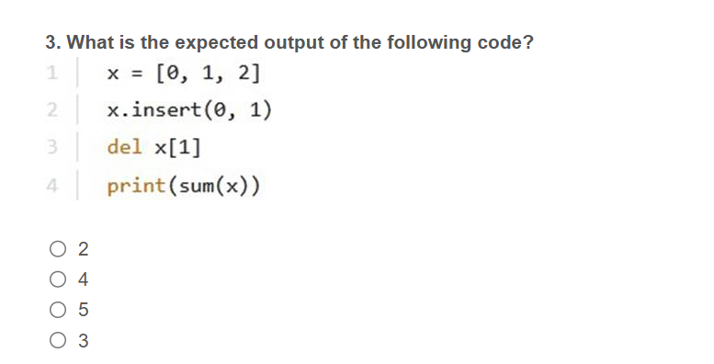
PCEP
.

Slide 5
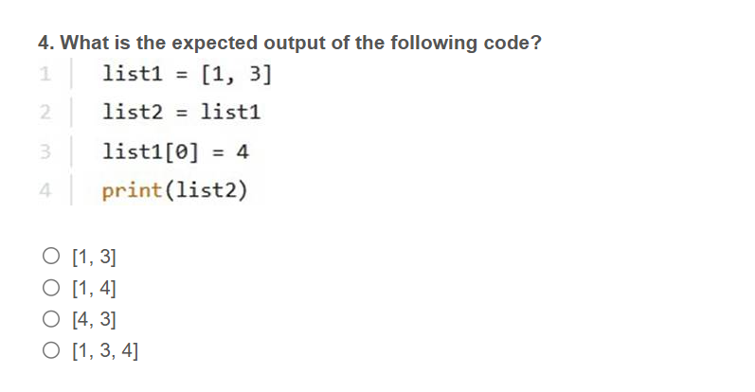
PCEP
.

Slide 6
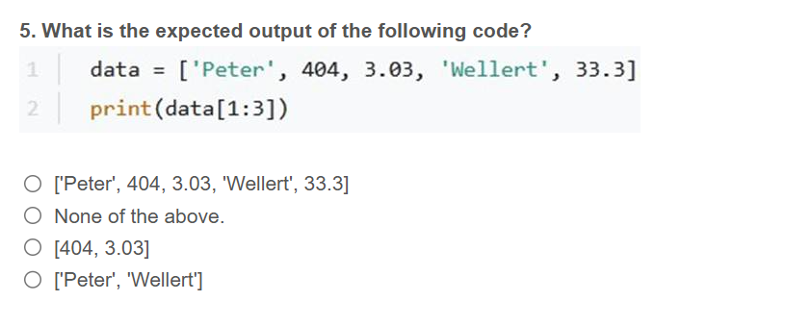
PCEP
.

Slide 7
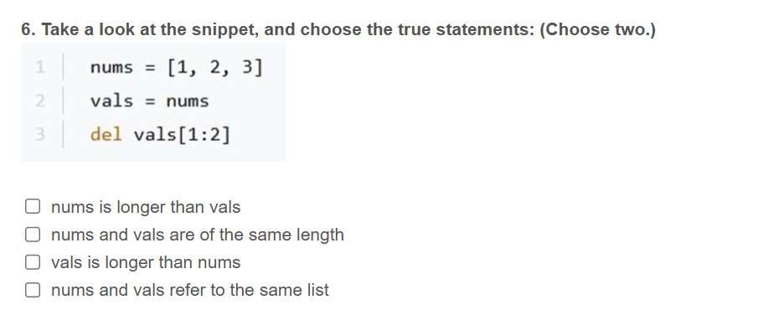
PCEP
.

Slide 8
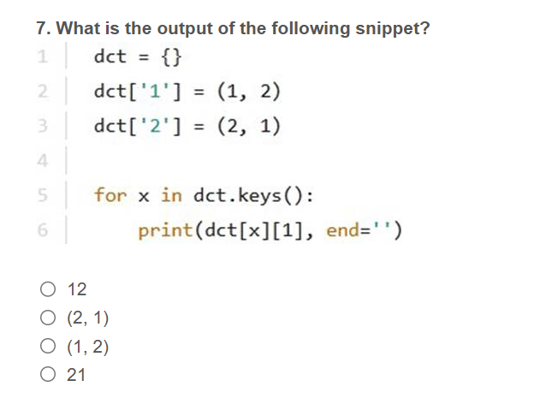
PCEP
.

Slide 9
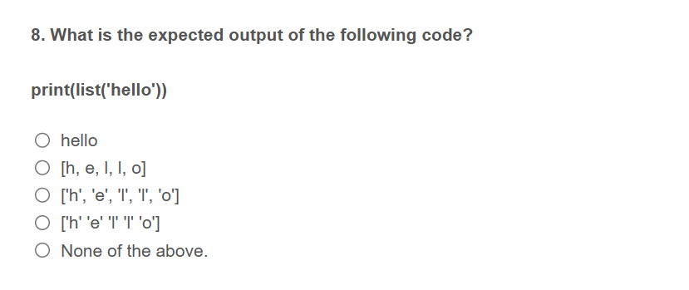
PCEP
.

Slide 10
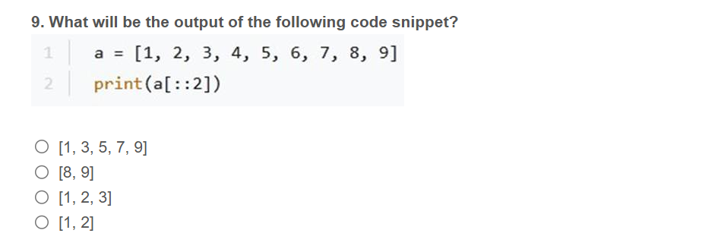
PCEP
.

Slide 11
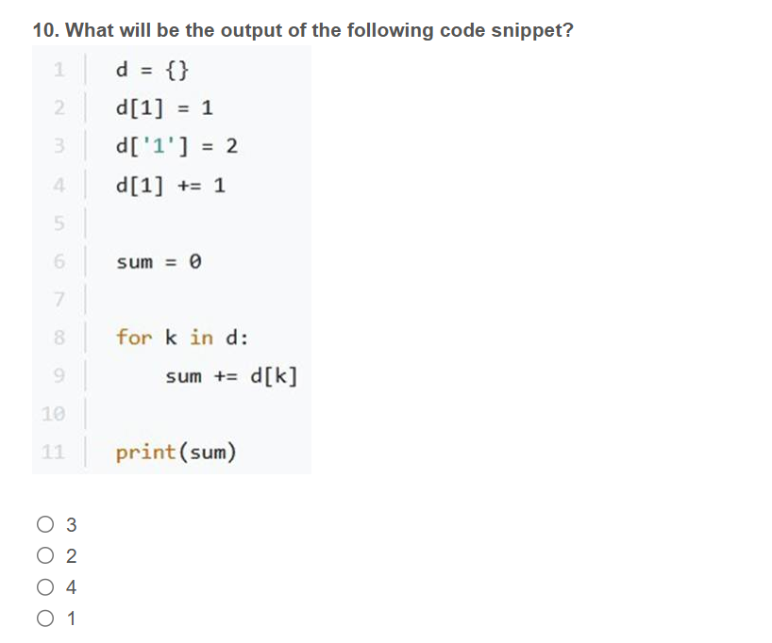
PCEP
.

Slide 12
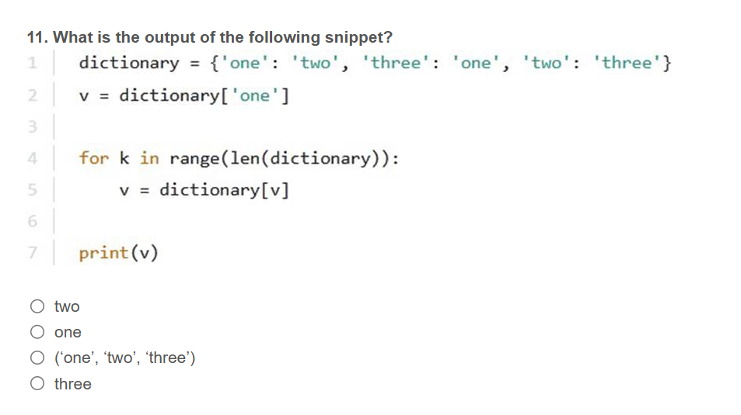
PCEP
.

Slide 13
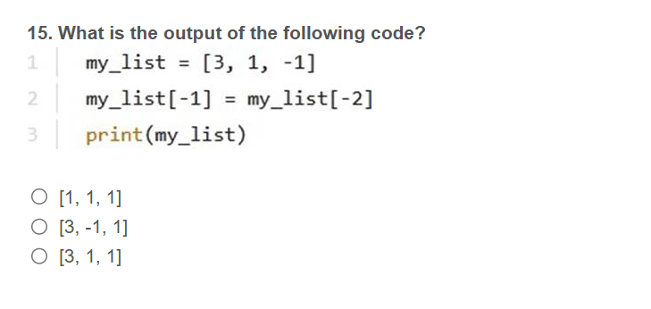
PCEP
.

Slide 14
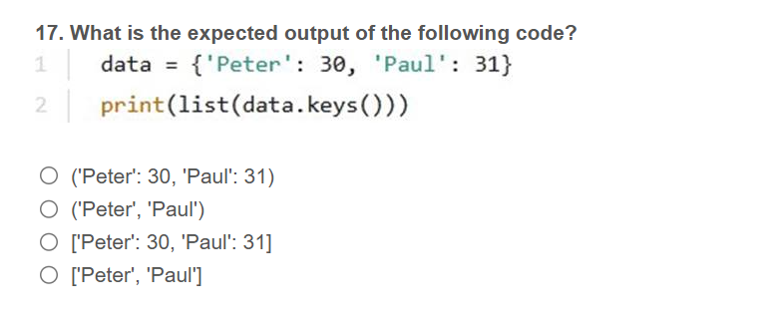
PCEP
.

Slide 15
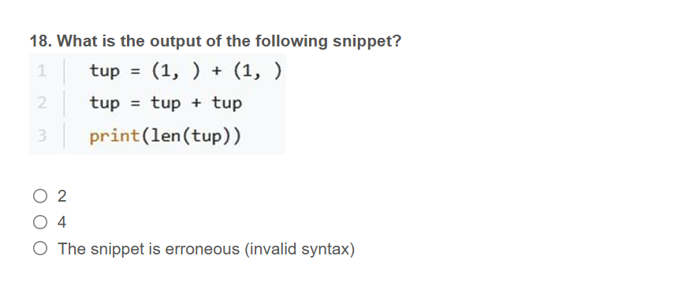
PCEP
.

Slide 16
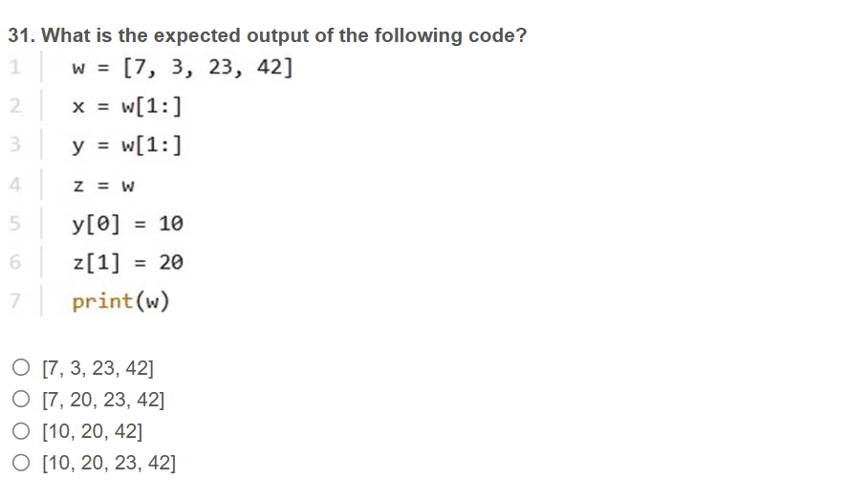
PCEP
.

